Slide 1



Noble Gas Analysis of Carbonaceous Chondrites
Laura Seifert, Tim Swindle
Arizona Space Grant Symposium 2016
April 15-16 2016 Tucson, AZ

Slide 2
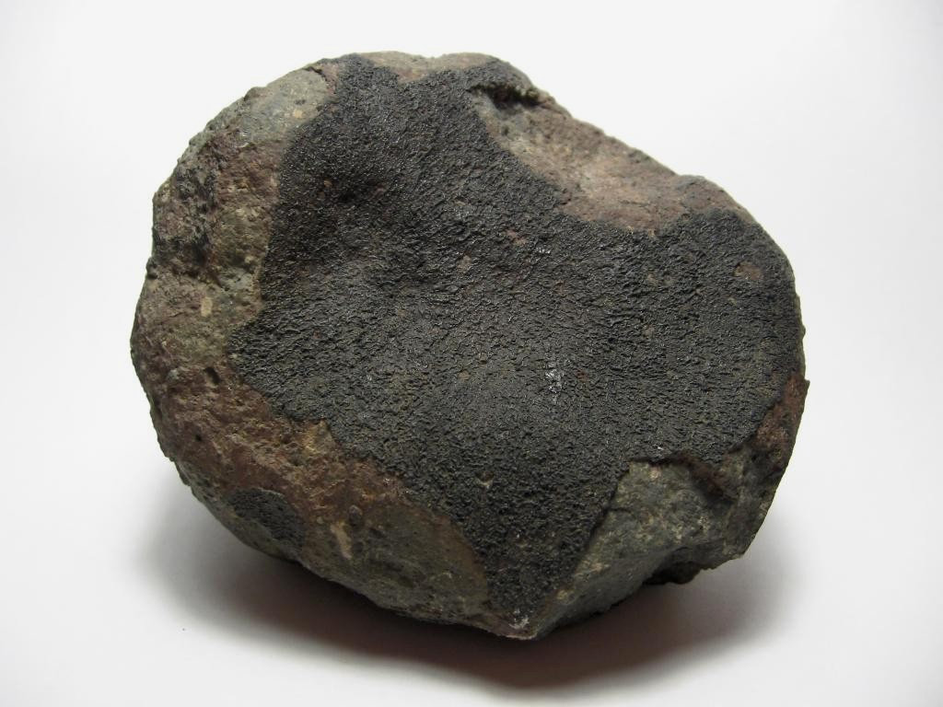
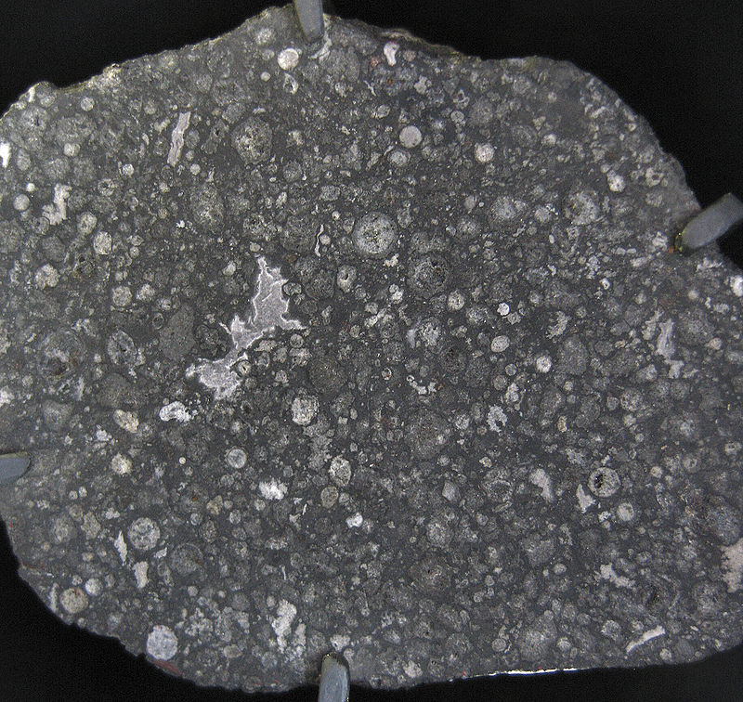

Background
What are carbonaceous chondrites?
  Type of meteorite: primitive composition, undifferentiated
Why are carbonaceous chondrites important?
  Information about the primitive solar system
  Presolar grains
https://en.wikipedia.org/wiki/Carbonaceous_chondrite

Slide 3
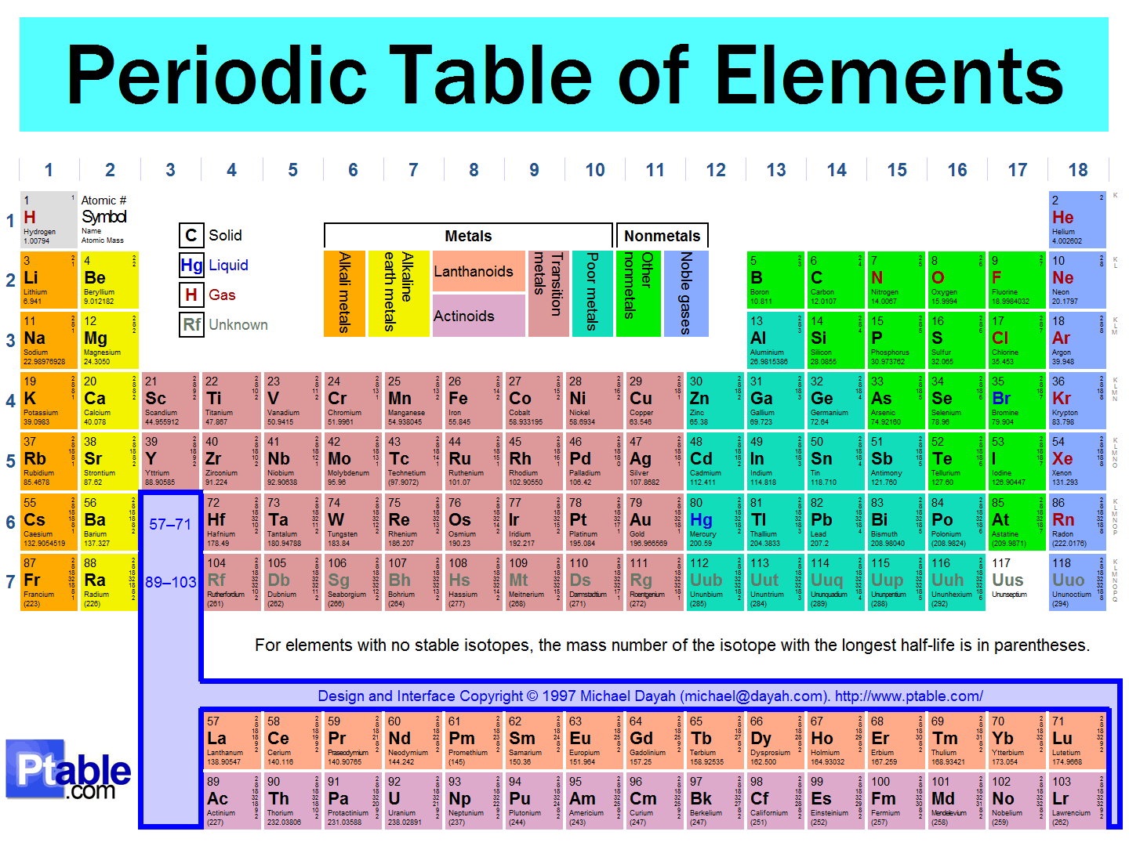
Background
Why use Noble Gases?
  Stable
  Relatively rare
  Isotopic variability
  Tracer: materials, processes, origins
http://www.ptable.com/Images/periodic%20table.png

Slide 4

Problem/Objectives
Two unusual (metamorphosed) chondrites carbonaceous, do not match any currently known
  Yamato 82162, 86720
Determine reservoirs sampled
Clues to evolution of unusual meteorites
Future research: exposure age

Slide 5
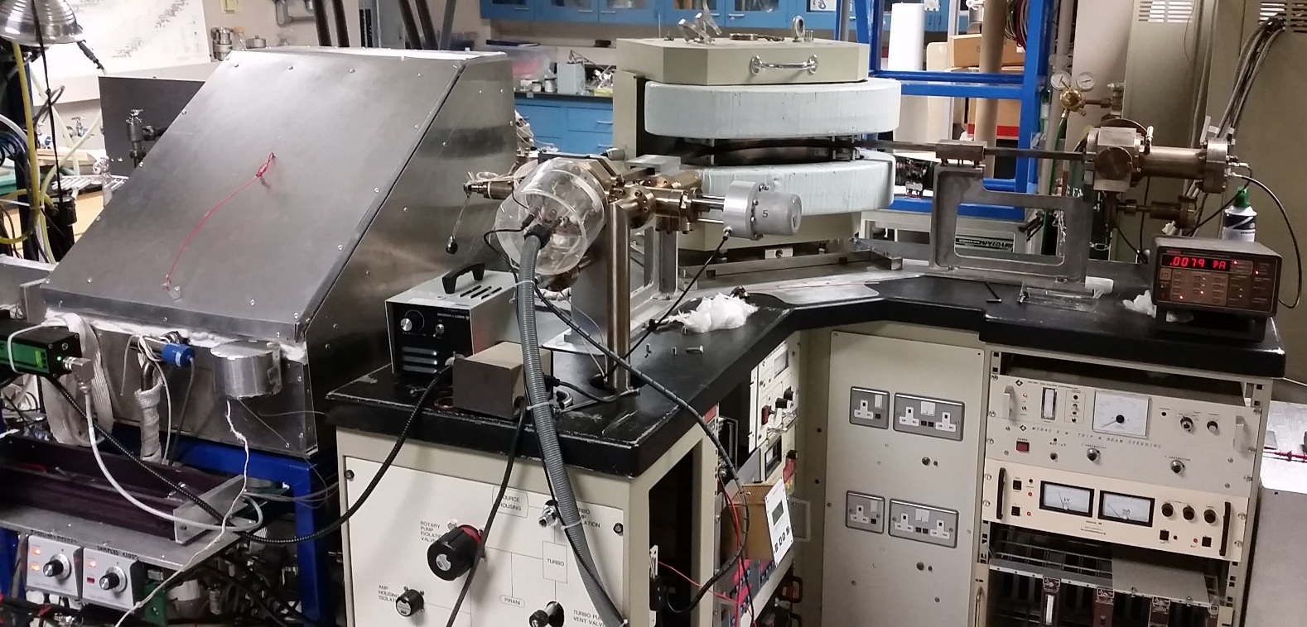
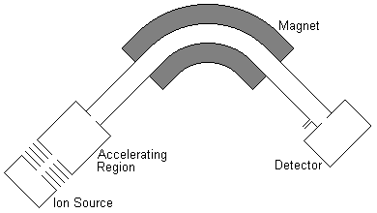
Methods
Noble Gas Mass Spectrometry
  Measures the relative ratios of different isotopes of noble gases
  Focus on Ar, Ne, Xe, Kr
  Compare our data to known values(Ott 2002)
http://sustainability.sellafieldsites.com/resources/labmouse/chemistry_as/images/1001b.png

Slide 6
Ott 2002

Slide 7
G(Presolar SiC)
Ott 2002

Slide 8
G(Presolar SiC)
Ott 2002

Slide 9
Interpretation/Conclusion
Y82162
  Normal carbonaceous chondrite with some terrestrial contamination
  Lack of presolar components
  Metamorphism
Y86720
  Dominated by terrestrial contamination

Slide 10

Acknowledgments
Special thanks to my mentor Tim Swindle, my lab manager Clark Isachsen and NASA Space Grant for making this project possible

Slide 11

Thank You

